Slide 1
Predicting sales for Favorita Supermarket

Slide 2
Problem Statement & Objective
Problem:
Supermarket operates within tight margins and fluctuating customer demand. Therefore, over-planning inventory can result in perishable wastage, but under-planning can lead to out-of-stock sales loss
Objective:
Forecast daily sales nationwide and for each store with 5% accuracy

Slide 3
How we obtained data
Four data tables were provided by the company: (1) Daily sales at each store by product family, (2) store locations, (3) crude oil prices, (4) holiday calendar
I obtained external data from Yahoo Finance and World Bank: (1) Crude oil and Exxon stock prices (2) CPI, population, and GDP/Capita
The dataset consists of daily entries from Jan 2013 to Aug 2017.

Slide 4
Data Wrangling
Aggregate sales data at national level:
Handle missing oil price data using forward fill method
Combine data provided by the company with external data
Identify public holiday dates (including those that were transferred)
Create sales data for each store

Slide 5
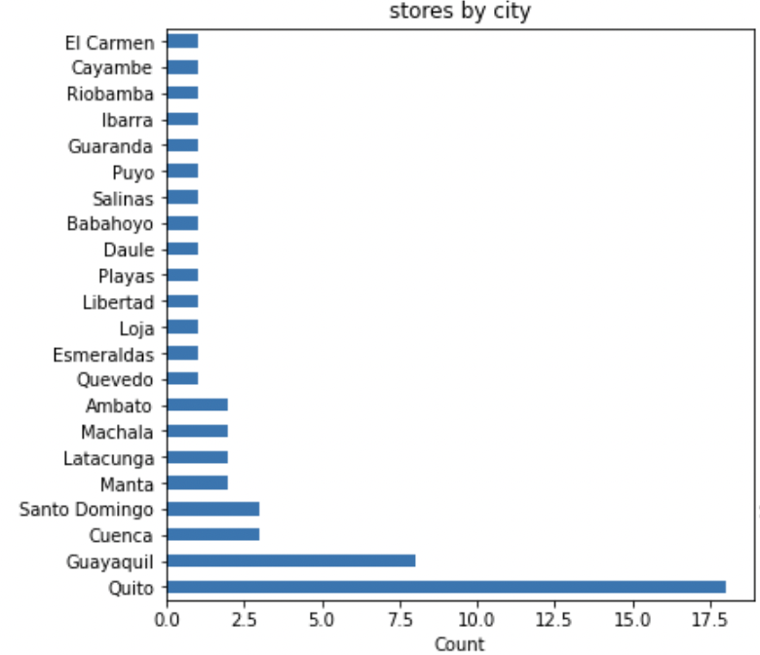
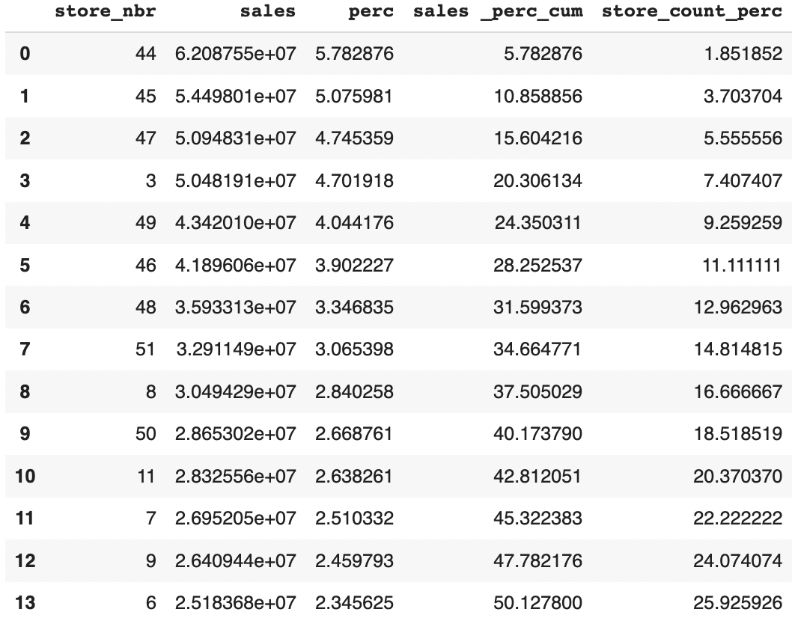
Data Exploration – Sales Distribution
Sales are dominated by the stores in the capital (Quito). The top 26% (14 stores) contributed more than 50% of the national sales

Slide 6
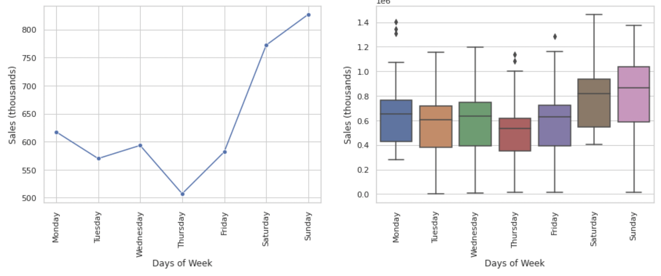
Data Exploration – Weekly Trend
Sales tend to increase from Thursday to Sunday.
Thursday has the lowest average (510) , Sunday has the highest average (826).
Weekday vs. Weekend significantly influence the daily sales

Slide 7
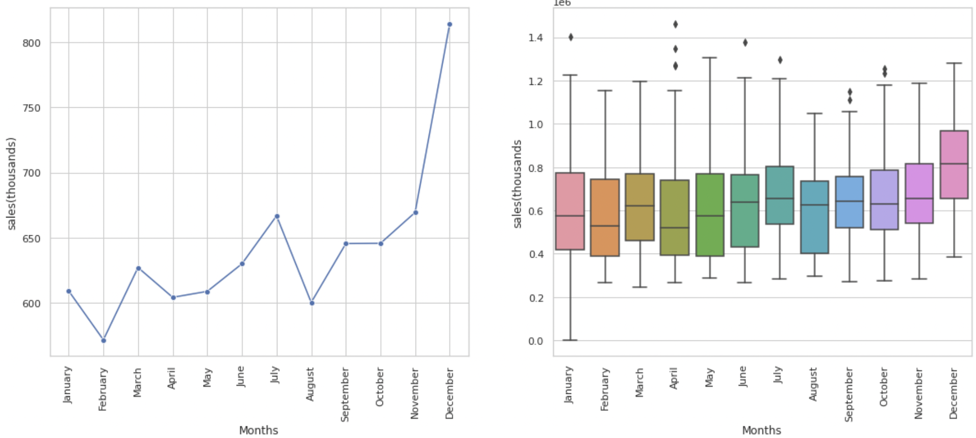
Data Exploration – Monthly Trend
Upward trending through out the year
3 peaks: March, July, and December
April have the most number of outliers

Slide 8
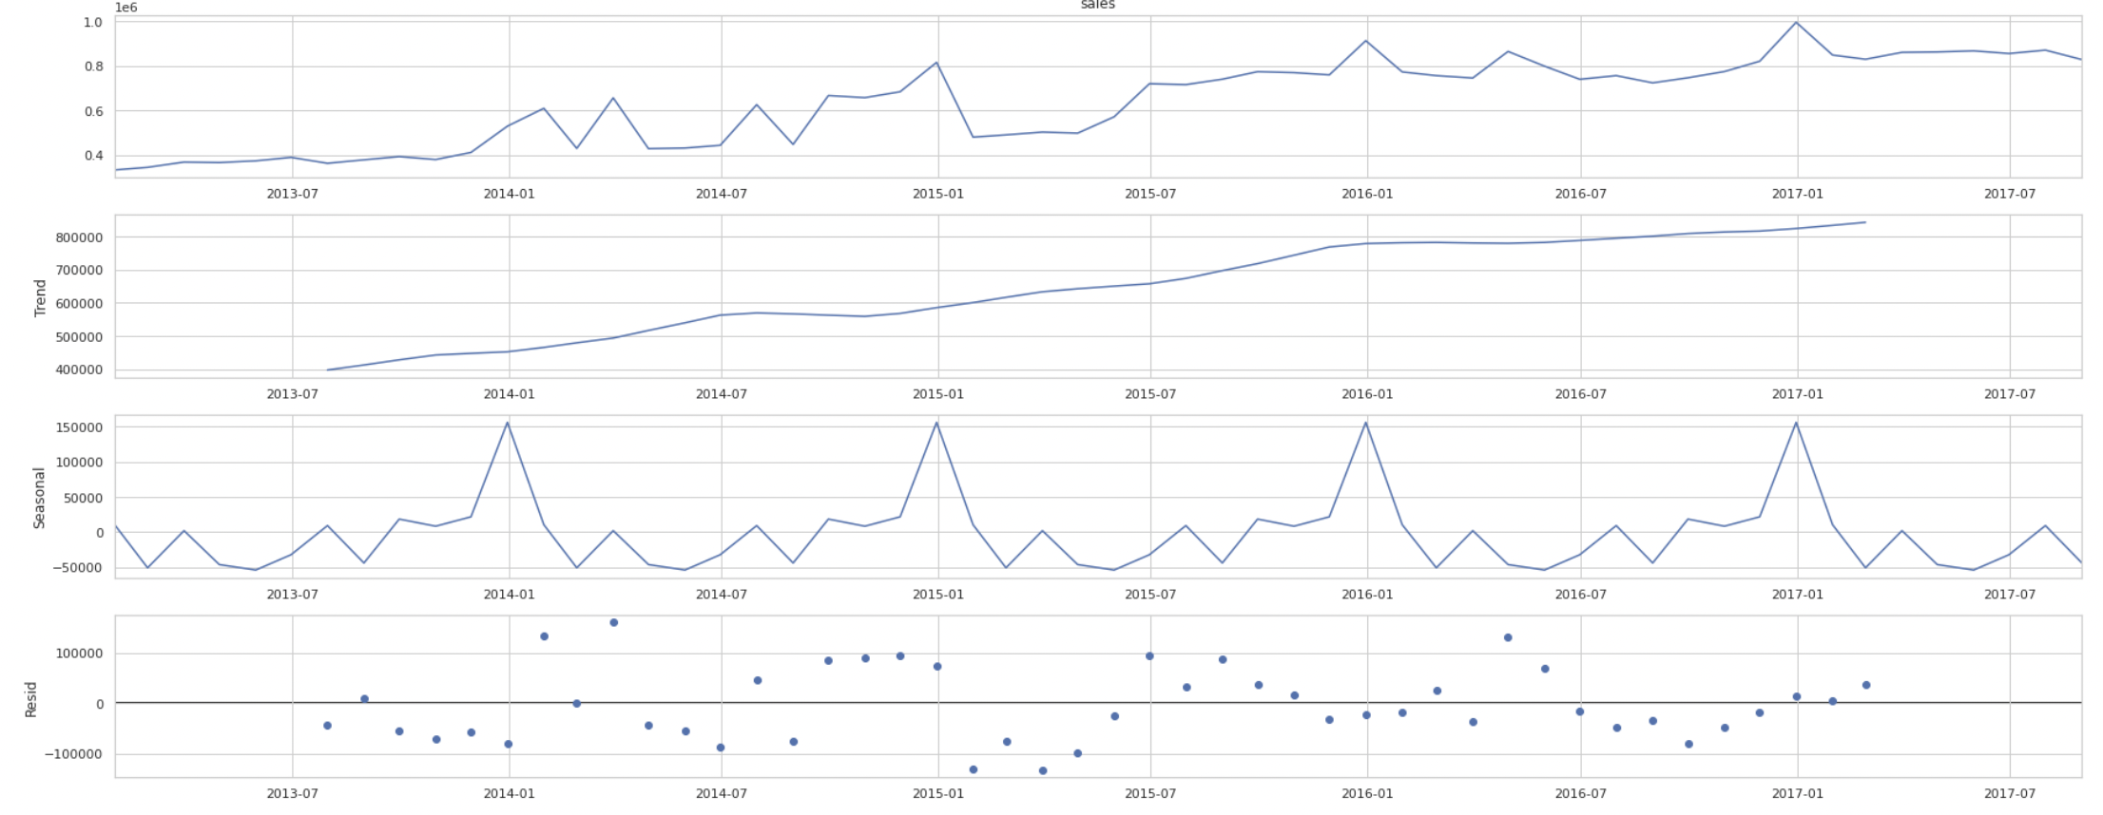
Data Exploration – Seasonality Decomposition
Sales increase over time
There is a clear seasonality in a year

Slide 9
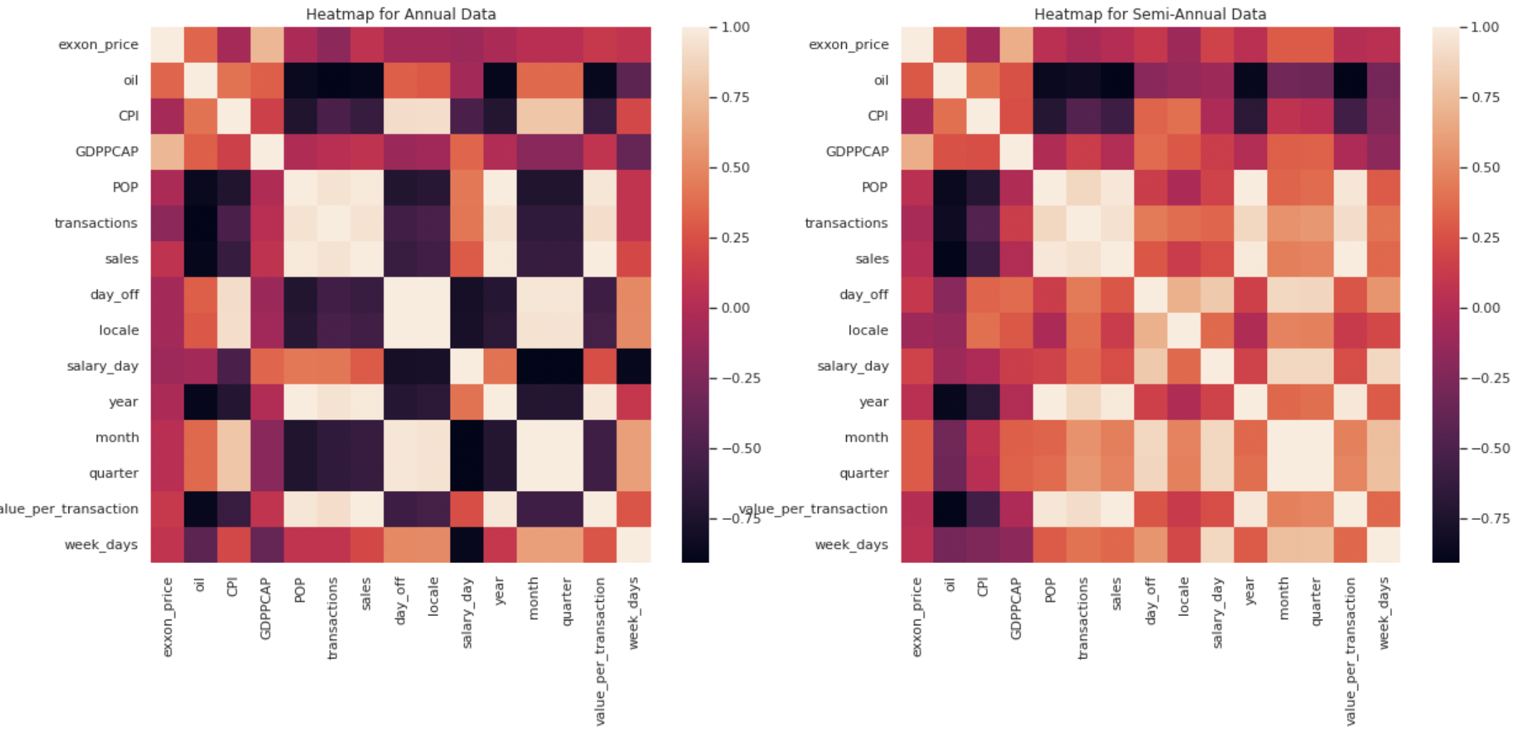
Data Exploration – Correlation analysis
There is a positive relationship (r > .5) between sales and the attributes listed below:
Population
There is a negative relationship (r < - .5) between sales and the attributes listed below:
Oil
CPI

Slide 10
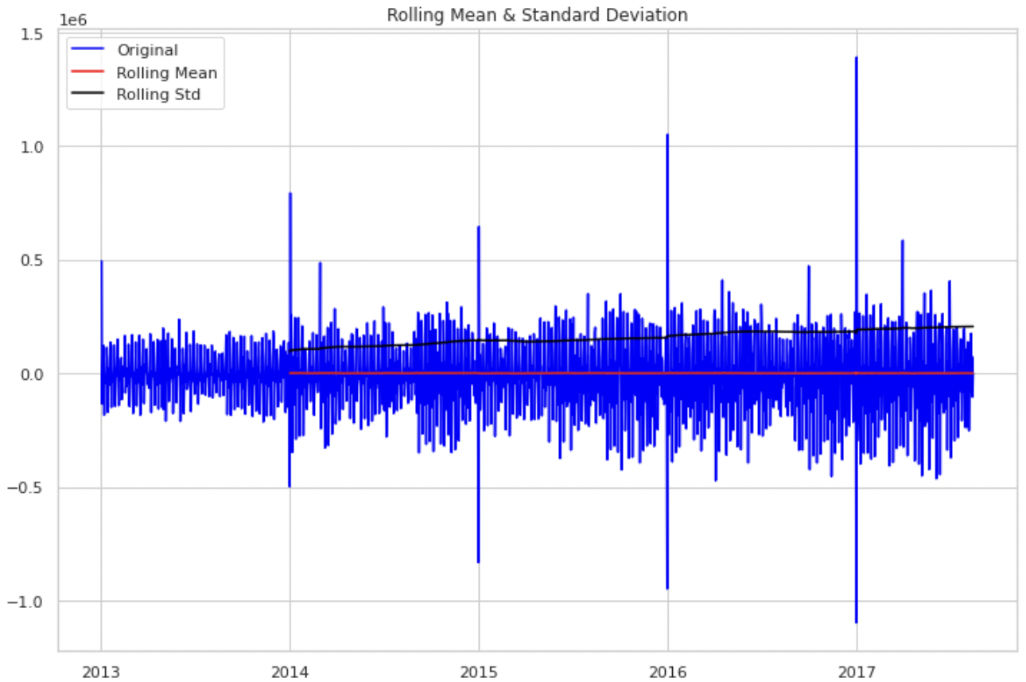
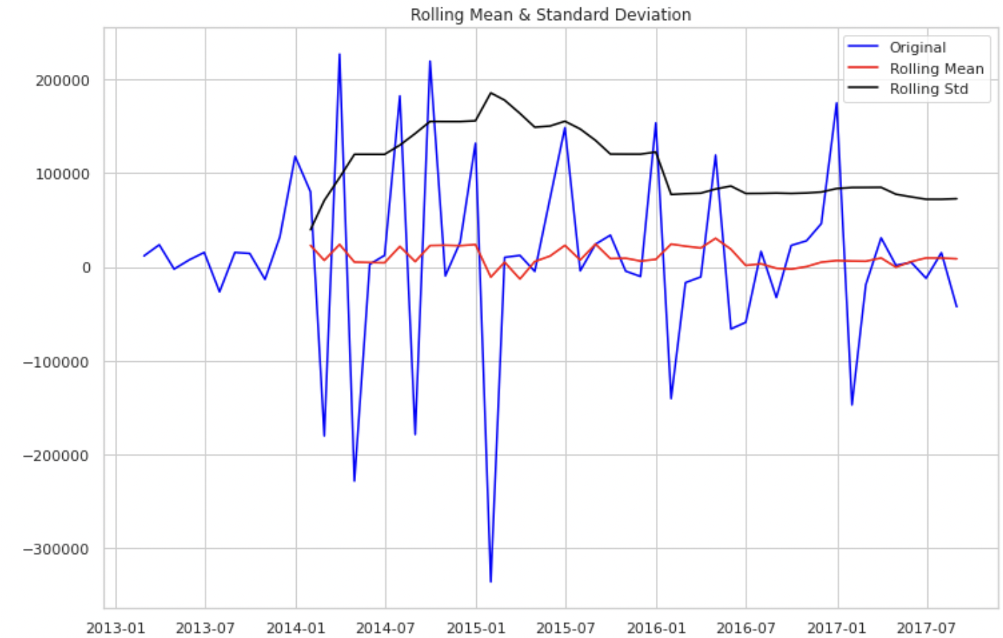
Stationarization
Both daily and monthly sales become stationary after first difference

Slide 11
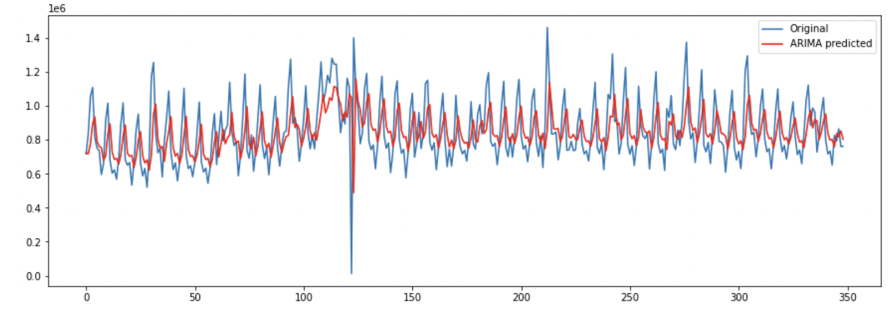
Modeling – Univariate Time Series Forecasting
These models are capable of only looking at the target variable
ARIMA models: the data became stationary after one difference so we set d = 1 and vary p and q values from 0 to 3

Slide 12
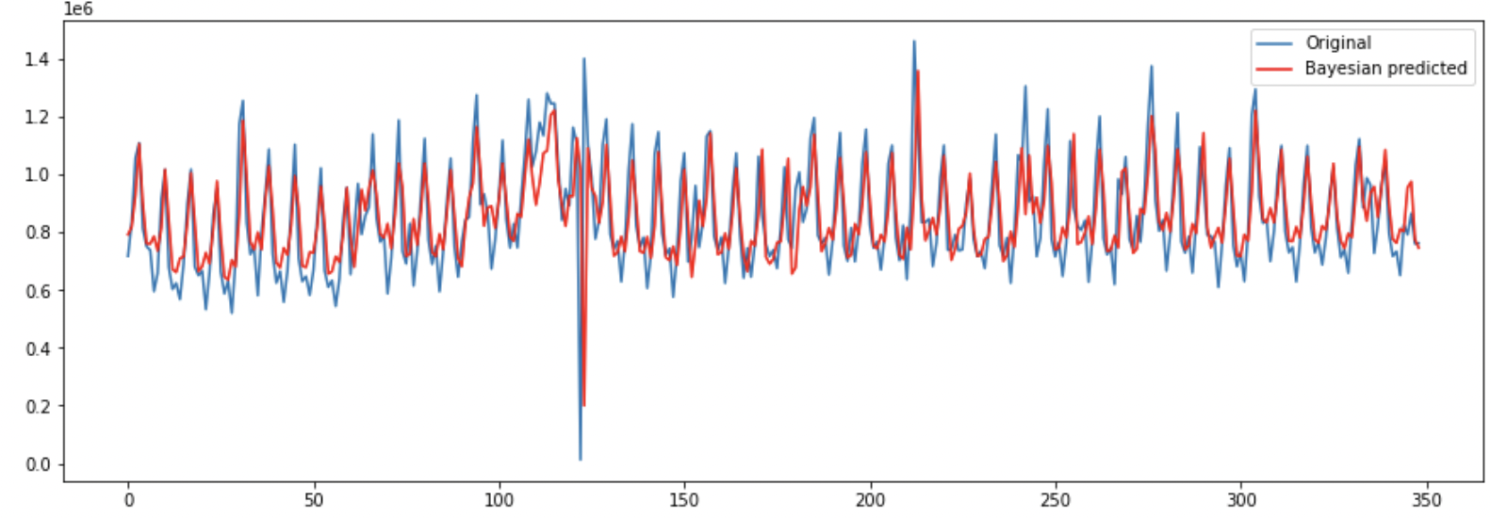
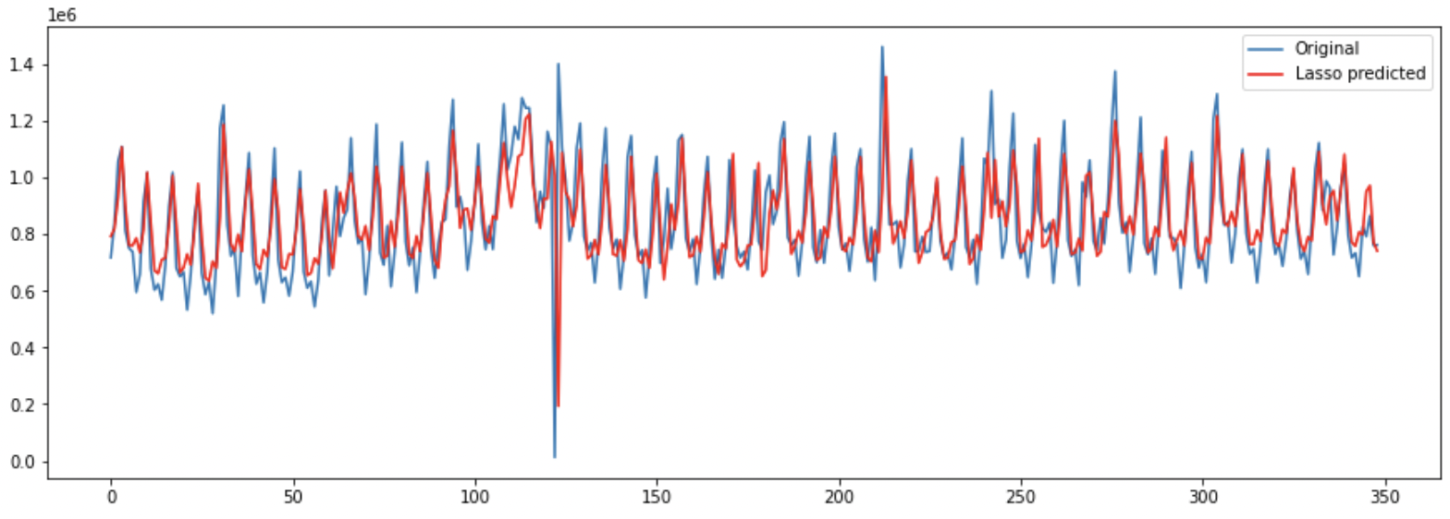
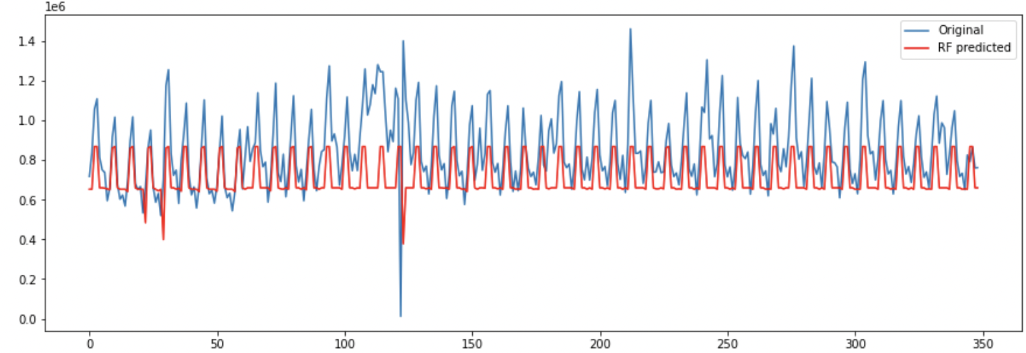
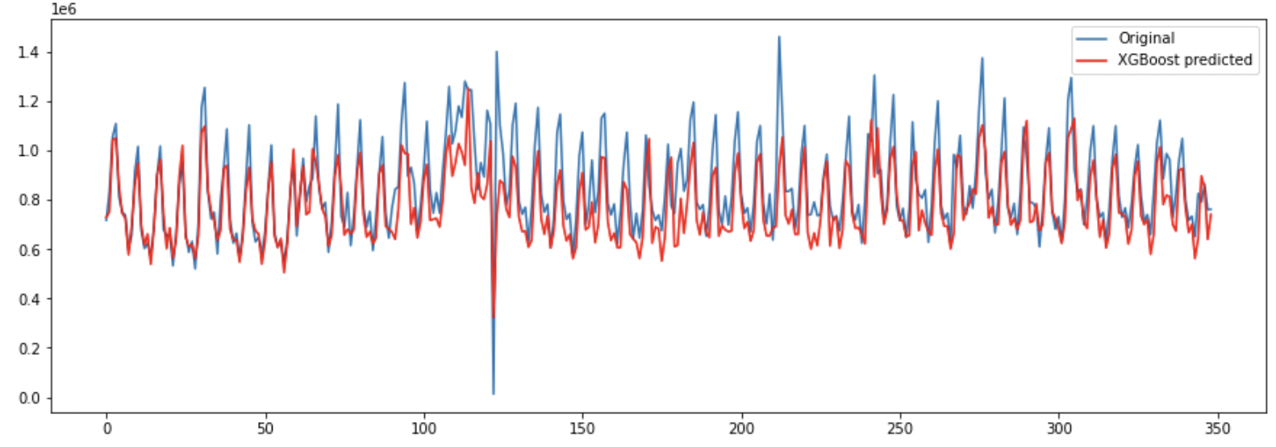
Modeling – Multivariate Time Series Forecasting
Baysian Ridge – MAPE 0.349
Lasso– MAPE 0.346
Random Forest – MAPE 0.360
XGBoost – MAPE 0.172

Slide 13
Modelling – Hyperparameter Tuning
"colsample_bytree": 0.5386589954893073,
"gamma": 1.500538354213392,
"max_depth": 9,
"min_child_weight": 3,
"reg_alpha": 145,
"reg_lambda": 0.20927620338609632,

